Slide 1

Foundations of Business

Slide 2
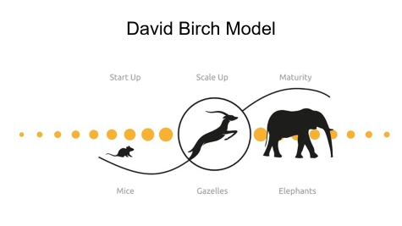


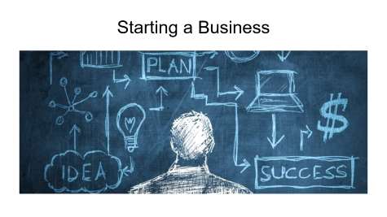
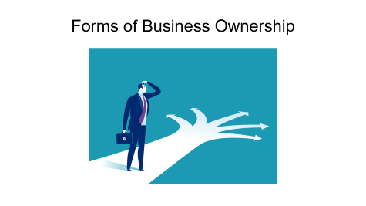

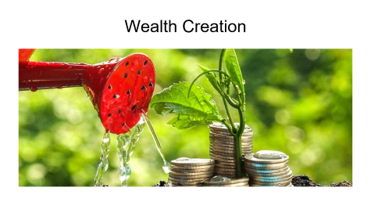

Business and Society

Slide 3

Wealth Creation

Slide 4
Wealth Creation
Wealth (n) “the annual produce of the land and labour of society” Adam Smith, 1776
Wealth creation: combining materials, ideas, labour, technology so that the output can be sold for more than costs. This profit brings wealth to the people and society involved in production.

Slide 5
Wealth Creation
Combination of inputs
Supportive environment
Means of production
Someone who will pay more than costs

Slide 6

Forms of Business Ownership

Slide 7

Forms of Private Business Ownership
Sole Proprietorships
Partnerships
Corporations
Not-for-Profit Corporations

Slide 8

Advantages and Disadvantages of:
Sole Proprietorships
Partnerships
Corporations
Not-for-Profit Corporations

Slide 9

Corporate Management
Shareholders – acquire shares in exchange for ownership
  Preferred Shares
  Common Shares
Board of Directors –
Corporate Officers & Managers –

Slide 10
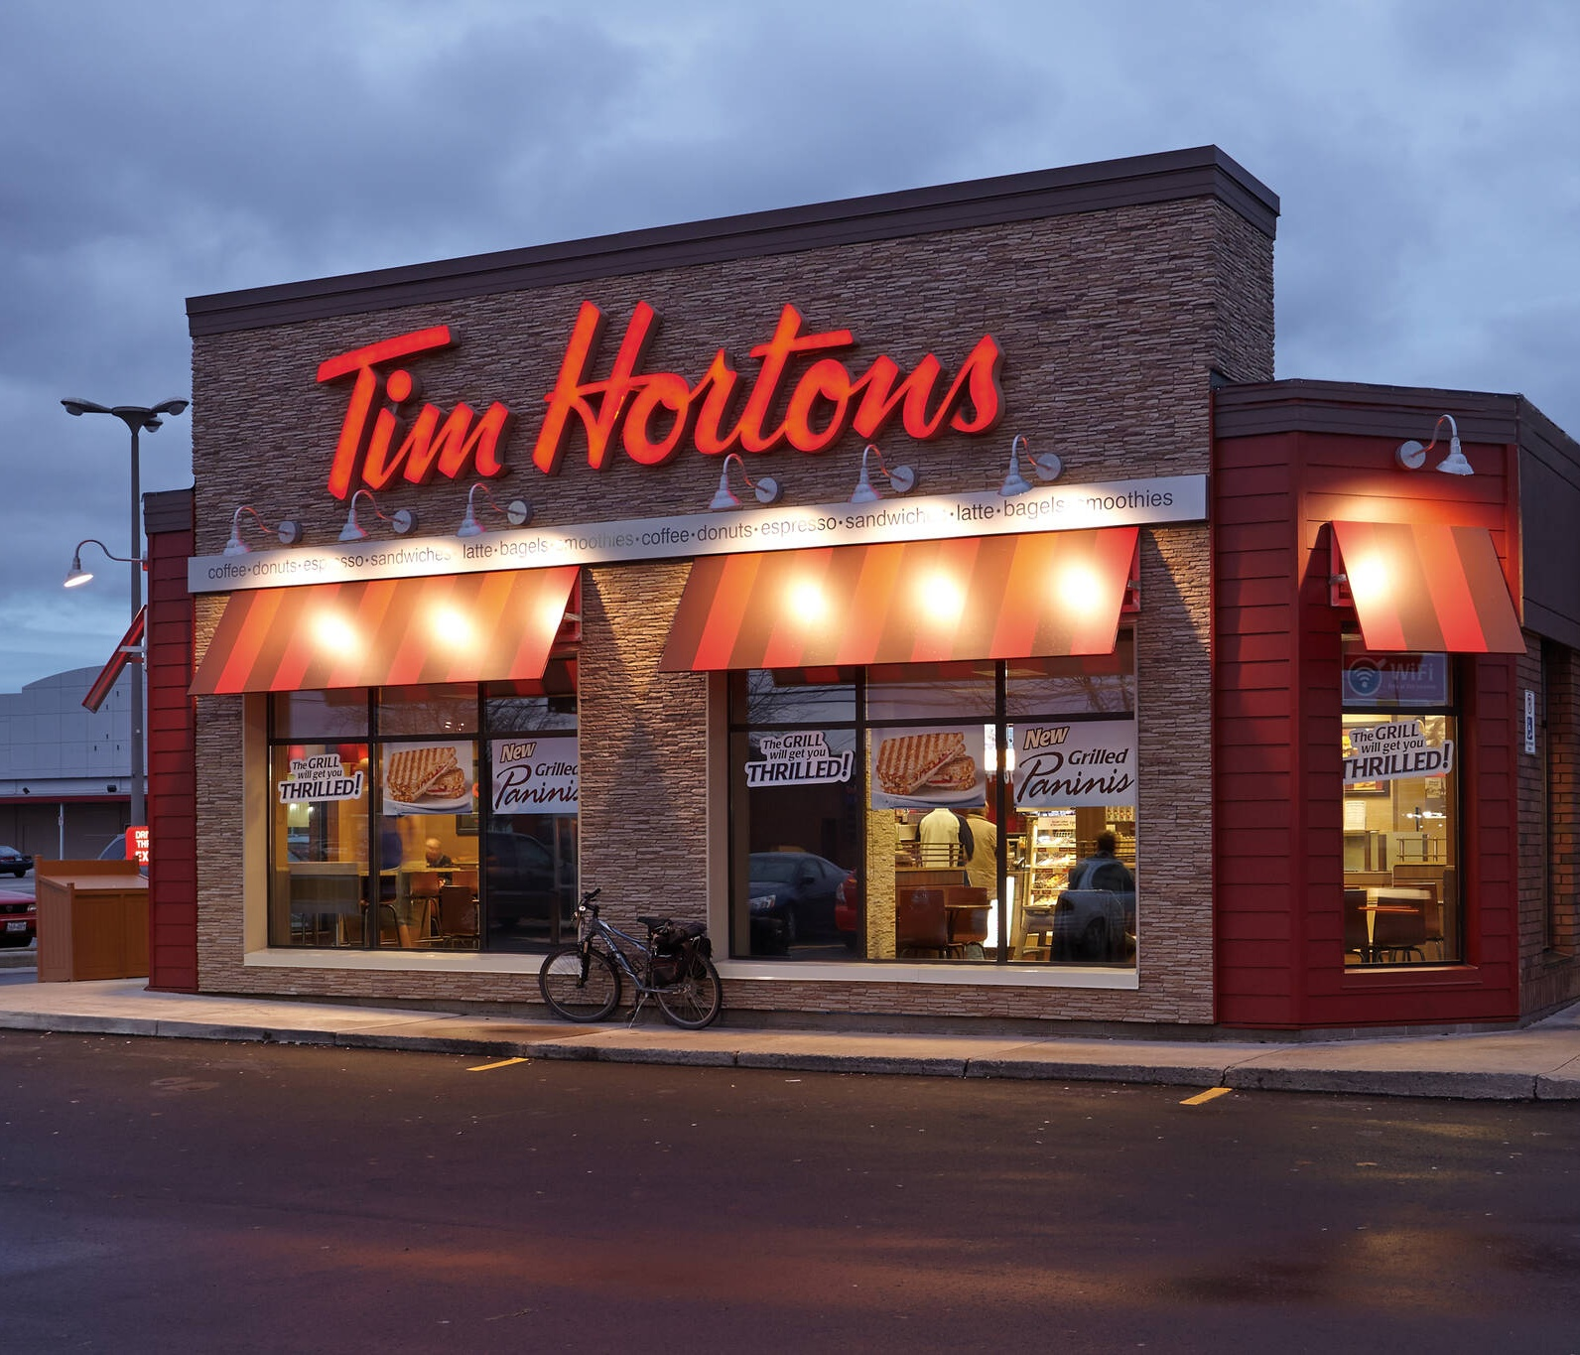
Franchising
A contract-based business arrangement between a manufacturer or other supplier, and a dealer, to produce and market the supplier’s good or service
    Example franchising opportunities:
        Subway
        Tim Hortons

Slide 11
The Franchising Sector
Franchising agreements exist between franchisee and franchisor
Canada has 76,000 individual franchise businesses operating under 900 different brand names
These franchises employ more than one million Canadians
More than $100 billion in sales each year
Franchising overseas is a growing

Slide 12
Franchising (Franchisee Perspective)
ADVANTAGES
DISADVANTAGES

Slide 13


Slide 14

Starting a Business

Slide 15

Finding Financing
Seed capital: The initial funding needed to launch a new vendor
Debt Financing
Equity Financing

Slide 16
Why Small Businesses Fail
Approximately 4% of small businesses close after one year
Approximately 15% of small businesses close permanently within three years
Approximately 30% of small businesses fail within five years

Slide 17

Why Small Businesses Fail
Management Inexperience
  Inadequate Financing
Meeting Government Regulations

Slide 18
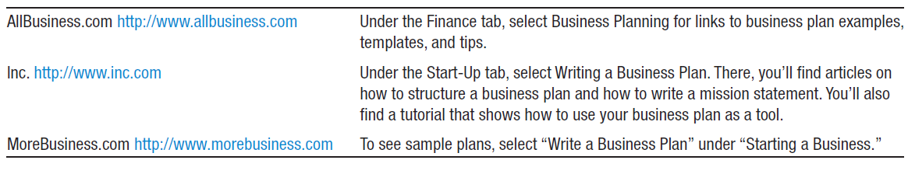
Creating a Business Plan
In the past, many entrepreneurs launched businesses without a formal business plan
Business plans help contemporary entrepreneurs prepare enough resources and stay focused on key objectives

Slide 19

The Business Plan: A Foundation for Success
Creating a Business Plan
  Written documentation that provides orderly statement of goals, methods, and purpose
  Discusses the company’s mission and vision
  Analyzes unique advantage, customers, and competition

Slide 20

Entrepreneurship

Slide 21

Entrepreneurship
The term ‘entrepreneurship’ has come to mean several different things:
Working for oneself, rather than for someone else (for a salary)
Entering a new market with new or existing products/ services; or an existing market with new products/ services
Operating a firm in which there is no separation between owner/ manager
The process of discovering, evaluating & exploiting opportunities
Creating new organizations of any type - not-for-profits as well as businesses – “social entrepreneurs”

Slide 22

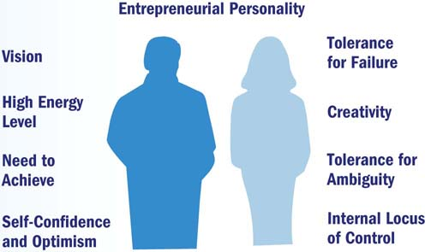
Characteristics of Entrepreneurs

Slide 23


Why People Become Entrepreneurs

Slide 24

Entrepreneurial Challenges
Entrepreneurship is the highest risk/ highest return activity in business:
Appeals to certain kinds of people – the possibility of bringing inventive ideas to life
Some entrepreneurs enjoy – are even passionate about - the process of launching a new company – business planning, product development, raising capital, hiring the right people, etc.
  Some of these “serial entrepreneurs” do it over & over again
Greatest challenges:
  Great difficulties in raising investment funds for a brazen, new idea
  Reality is nearly always very different from what was planned
  High failure rate - even after initial funding secured

Slide 25

Small Businesses vs. Entrepreneurial Businesses
3 key differences:
Size – small businesses remain small; new entrepreneurial ventures are small now, but are expected to grow rapidly, going forward
Age – small businesses may have been that way for many years, even generations; as entrepreneurial ventures age, they grow-up
Growth goals – small businesses are not expected to grow significantly; may have growth potential, but owners unwilling to take required steps for growth
  Because growth is a priority for entrepreneurs, founders will often sell a stake in the business to investors (and give up some control) to fuel growth

Slide 26
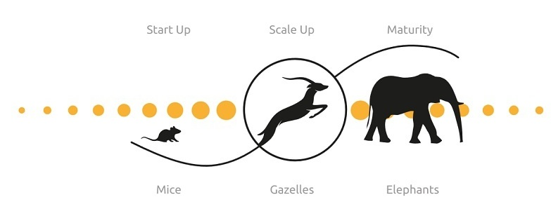
David Birch Model

Slide 27

Mice
The vast majority of businesses in Canada are quite small
  94.7% of companies employ fewer than 50 people
  together generate enormous economic activity & employment
Typical examples: small retailers, local service firms (restaurants, auto repair), independent service businesses (consultants, freelancers, designers)
Can typically change direction quickly
Many do not aspire to grow large, so long as they remain attractively profitable

Slide 28
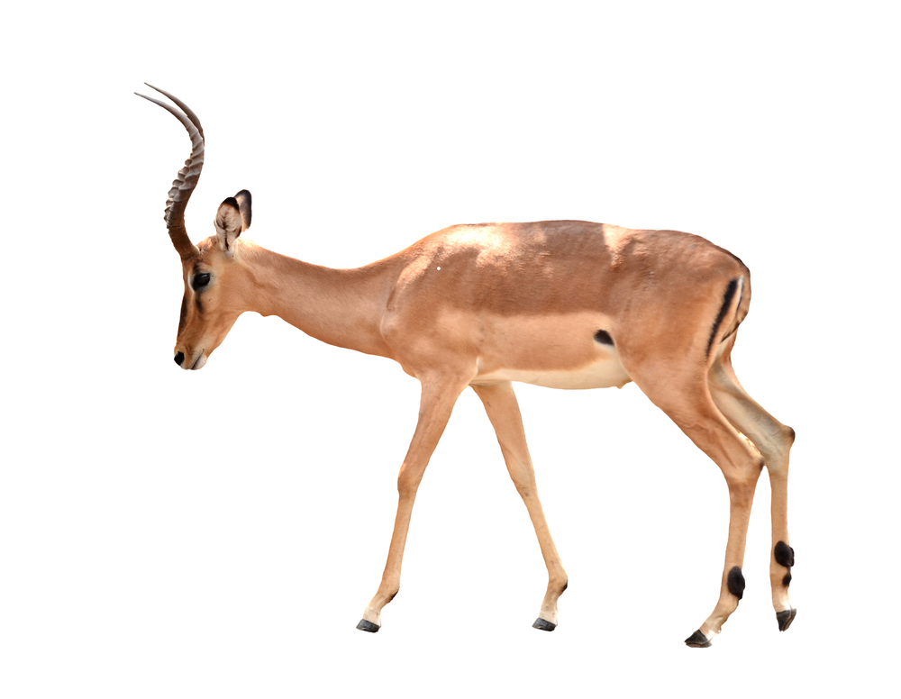
Gazelles
Based on Birch’s definition – a gazelle is a firm that seeks rapid growth AND above average profitability – grows by at least 20%/ year for four years (from a modest $100,000 minimum starting point) – results in a doubling in size in 4 years
Often includes a radical business innovation/ implementation of new technology
Not all gazelles are young – many firms only “take-off” after a long period of gradual growth.
  Why? New opportunities in the marketplace, entrepreneurial management

Slide 29
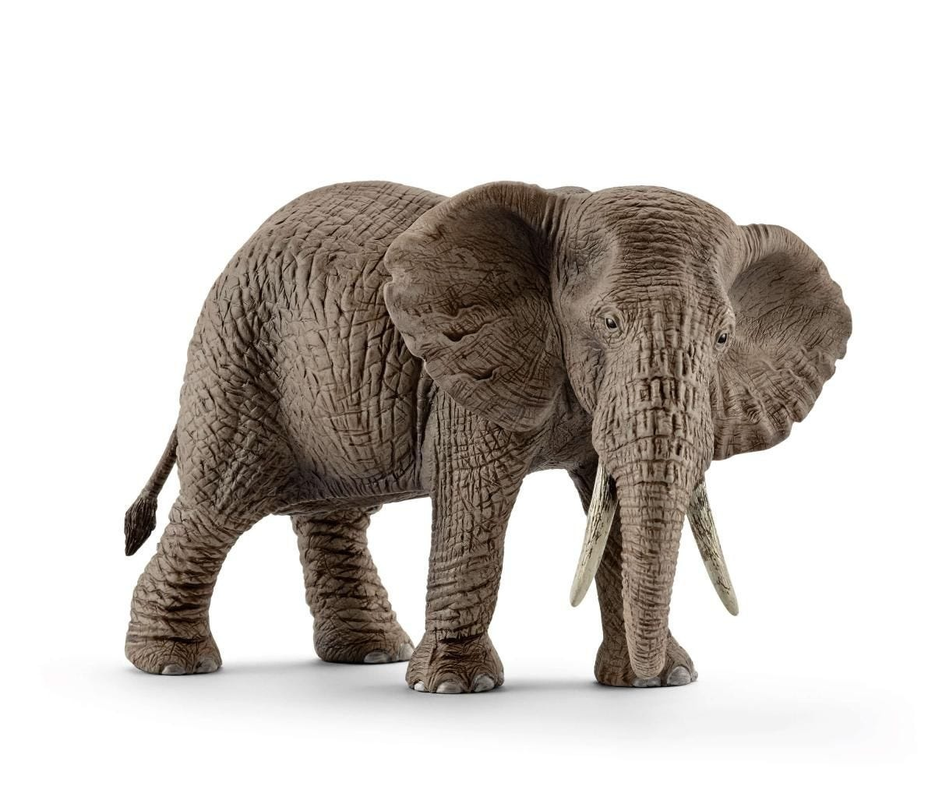
Elephants
Large, mostly well-known firms – “Fortune 500
Considerable overall marketplace power
Difficult for them to change direction quickly
Collectively, they have fired more people than they have hired in the past 25 year

Slide 30

Coach
Case Study
Why Gen Z Fell in Love with Coach
Business, Society & Wealth Creation

Slide 31

CNBC Video: Why Gen Z Fell in Love with Coach
https://www.youtube.com/watch?v=EFoUBRfwzWQ&t=1s

Slide 32

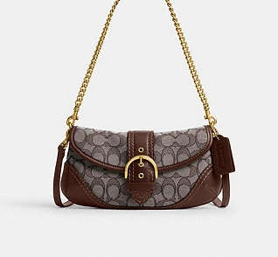
What happened to Coach and why?

Slide 33


How did Coach reverse its decline in brand value?
Stuart Vevers
2013

Slide 34





How did Gen Z engagement drive sales growth?
Lil Nas X
Megan Thee Stallion

Slide 35


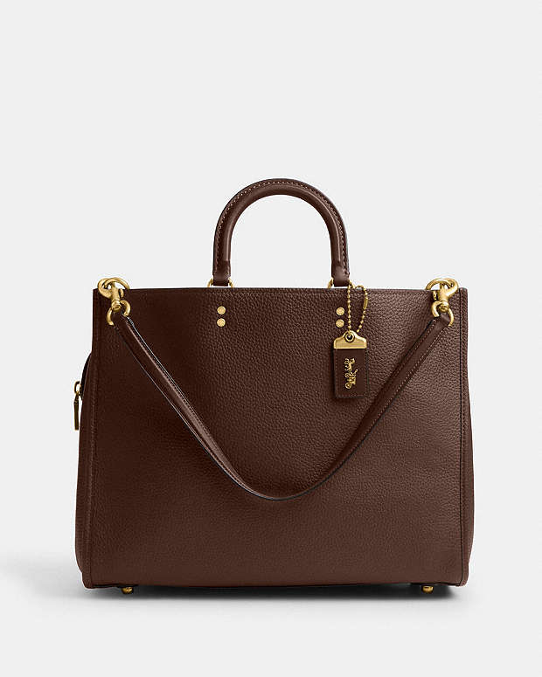
BROOKLYN
TABBY
ROGUE
How did product and pricing strategy support accessible luxury?

Slide 36

What role did leadership changes play in Coach’s turnaround?
Todd Kahn

Slide 37

Questions?

Slide 38
Self Study

Slide 39

What is a Small Business?
Industry Canada defines a small business as an “independent business with fewer than 100 employees and revenues less than $2 million”
Small businesses account for approximately two-thirds of the employment in five Canadian industries: non-institutional health care, construction, accommodation and food, forestry, and other services

Slide 40
Most Businesses are Small Businesses
Approximately 97% of Canadian firms have fewer than 100 employees on staff
  Canada has approximately 2.7 million self-employed individuals
Small businesses are a launching pad for entrepreneurs

Slide 41
Contributions of Small Business to the Economy
Create New Jobs
  Account for more than 29% of the GDP
  Offer Customized Services
  Create New Industries
Encourage Innovation

Slide 42
Typical Small-Business Ventures
  Benefits
  Allows for more control of business
  Allows for more control of personal time
  Keeps startup and operating expenses low
  Drawbacks
Owner can feel isolated
Business has less visibility to customers
Home-Based Business

Slide 43
Public (Government) Ownership of Business
A government unit or agency owns and operates an organization
Examples: Manitoba Hydro, Toronto Transit Commission (TTC)

Slide 44
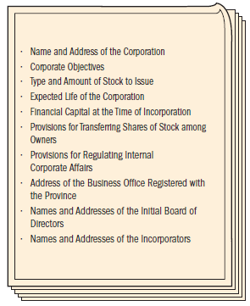
Organizing a Corporation
Most small businesses are incorporated in the provinces where they operate, but they may choose to incorporate in any province
Incorporation can be done at the federal or provincial level
Information in the articles of incorporation (right) forms the basis on which a government grants a corporate charter

Slide 45
Who will create wealth?
Entrepreneurs
  From sole proprietors to public companies
SME (small and medium sized enterprises)
Large corporations
  Private and public
Government institutions

Slide 46
Who will help? Assistance for Small Business
Investors (angels, venture capitalists, banks, government, etc.)
Local, provincial, national governments
  Supply infrastructure, tax incentives, etc.
Business development bank of Canada is a place where only entrepreneurs can get money, advice, expertise
  http://www.bdc.ca/EN/Pages/home.aspx

Slide 47

Assistance for Small Businesses
When a bank loans money to a small business and it is not paid back, the government will guarantee payment of 85% of the loan if the loan applicant had successfully applied to the Canada Small Business Financing Program
Business Incubators
  Local community initiatives to share resources for small startups. The Canadian Association of Business Incubators is a national association of member organizations
  Canadian Acceleration and Business Incubation

